Slide 1

Applied Data Science Capstone
Name: Yunus Emre Kahraman
Date: 04.04.2025

Slide 2

Executive Summary

Slide 3

The goal of this project is to apply nearly everything learned in the IBM Data Science course in a practical setting.
The dataset includes general information about SpaceX rockets, covering their launches, success rates, costs, and other relevant details.

Slide 4

Methodology

Slide 5

Methodology Overview
In this project, a multi-step data science process was followed, starting from data collection and cleaning to exploratory data analysis and machine learning. Various tools and technologies were applied to ensure a comprehensive understanding and actionable insights.

Slide 6

Methodology – Data Collection & Wrangling
SpaceX launch data was collected from the official SpaceX API and complemented by additional sources. The raw data was transformed into structured formats using Python (Pandas).
Main tasks:
Merging datasets from different sources
Handling missing values and inconsistent formats
Converting timestamps and coordinates into usable formats
Feature engineering (e.g., creating success/failure labels)

Slide 7

Methodology – EDA & Interactive Analytics
Exploratory data analysis was performed using SQL queries and Python libraries such as Matplotlib, Seaborn, and Plotly.
Steps involved:
Identifying launch patterns based on sites, dates, and rocket types
Investigating the relationship between payload mass and success rates
Creating interactive dashboards using Plotly Dash
Displaying launch sites on an interactive Folium map

Slide 8

Methodology Predictive Analysis
Machine learning models were used to predict whether a rocket launch would be successful based on several features.
Approach:
Data was split into training and test sets (80/20)
Logistic Regression and Random Forest classifiers were applied
Accuracy, precision, and recall were calculated for evaluation
The best-performing model was selected based on test accuracy

Slide 9

EDA & Visual Analytics

Slide 10

Tools and Libraries
For EDA and visualization, a variety of tools and libraries were used:
Pandas & NumPy for data manipulation
Matplotlib & Seaborn for static plots
Plotly for interactive charts
Folium for geospatial visualization
Dash for creating interactive web dashboards
These tools allowed deeper insights into the dataset through flexible visual representations.

Slide 11

Key Exploratory Steps
Several analytical steps were taken to understand the data better:
Grouped launches by site, year, rocket type
Calculated success rates across various categories
Analyzed the distribution of payload mass
Investigated cost per launch and its correlation with outcomes
Mapped launch locations using latitude & longitude

Slide 12

Interactive Dashboard Features
A fully interactive dashboard was built using Plotly Dash, allowing dynamic exploration of SpaceX launches:
Dropdown to select launch site
Pie charts to show success vs. failure per site
Scatter plots for payload vs. outcome analysis
Map view of all launch locations using Folium
These features enabled real-time interaction and deeper data exploration by the user.

Slide 13

EDA Visualization Results

Slide 14

Flight Number vs. Payload Mass
We analyzed how flight experience and payload mass relate to launch success.
A categorical scatter plot was created using FlightNumber and PayloadMass on the x and y axes.
Data points were colored based on the Class (0 = failure, 1 = success).
As the number of flights increases, the success rate of landings also increases.
Surprisingly, heavier payloads did not significantly reduce the success rate.
This suggests that both experience and engineering improvements contributed to more reliable launches.

Slide 15
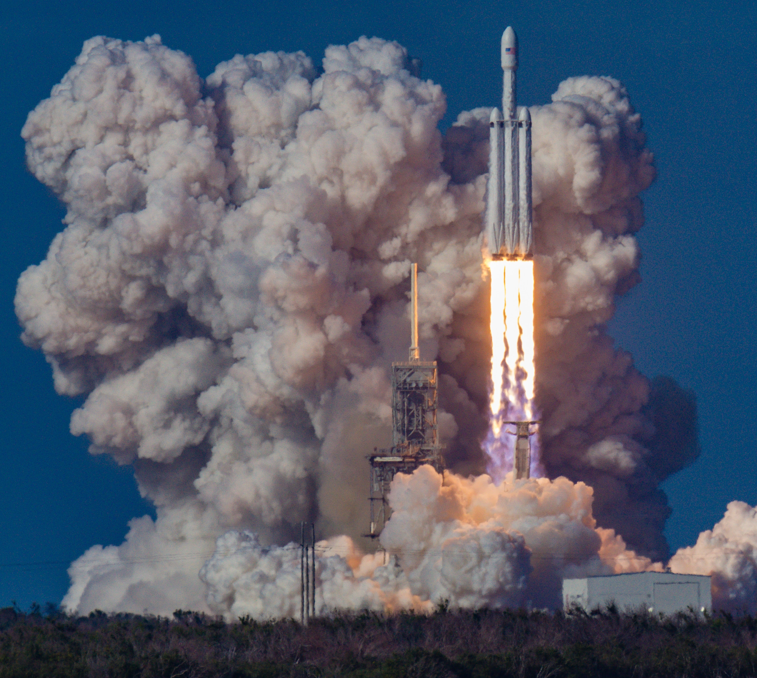
Flight Number vs. Launch Site
A scatter plot was generated to show how the number of launches varies across launch sites.
Hue color shows success (1) vs. failure (0).
Certain sites show higher success rates over time, indicating operational learning and improvement.
Notably, the CCAFS LC-40 and KSC LC-39A sites showed increasing success over time.

Slide 16

Payload Mass vs. Launch Site
Scatter plot reveals how payload mass affects launch success across different sites.
The VAFB-SLC site did not host launches with payloads greater than 10,000 kg.
Other launch sites demonstrated a broader range of payloads with consistent success.

Slide 17

Flight Number vs. Orbit Type
A scatter plot explored the correlation between orbit type and flight number.
In LEO missions, launch experience positively correlated with success.
In GTO missions, no clear trend was observed, suggesting more complex challenges.

Slide 18
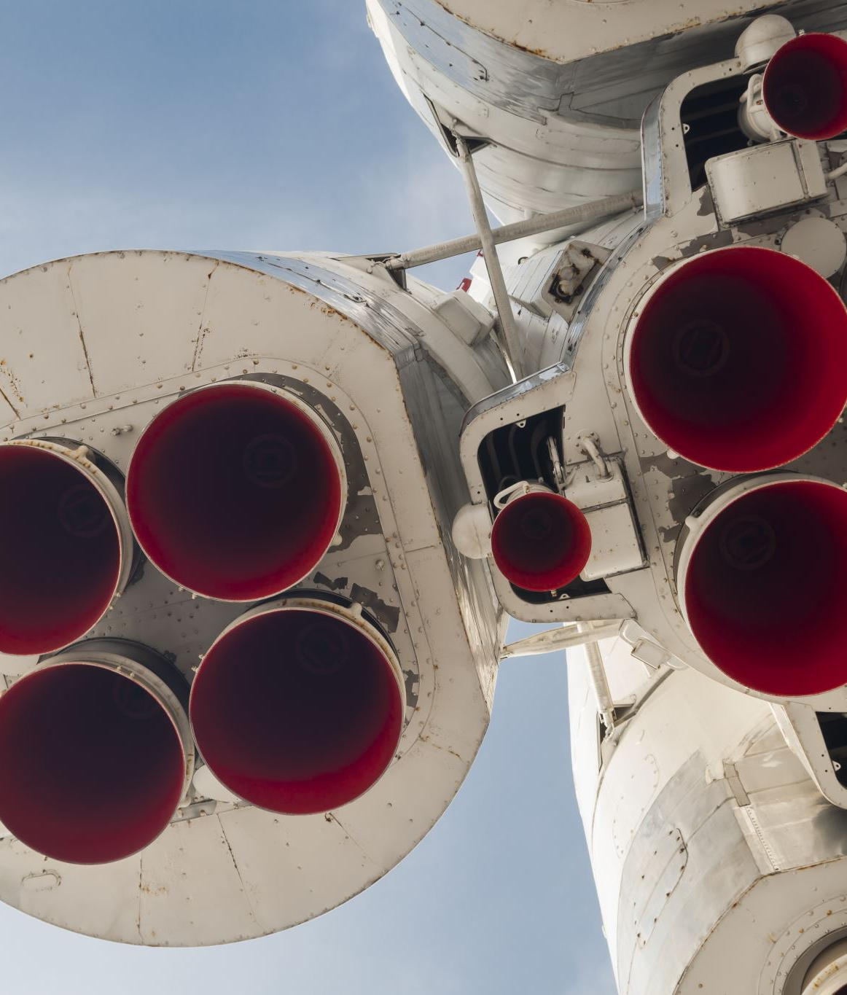
Payload Mass vs. Orbit Type
A scatter plot visualized how different orbit types relate to payload mass.
Heavier payloads were more frequently launched to GTO, yet had lower success.
Light to moderate payloads had higher success in LEO and ISS missions.

Slide 19

SQL EDA Results

Slide 20

Launch Site Distribution
Description: The dataset contains multiple launch sites used by SpaceX, including Kennedy Space Center and Cape Canaveral Air Force Station.
Insight: Understanding launch site distribution is crucial for identifying geographic dependencies, evaluating site-specific performance, and planning future infrastructure investments.

Slide 21
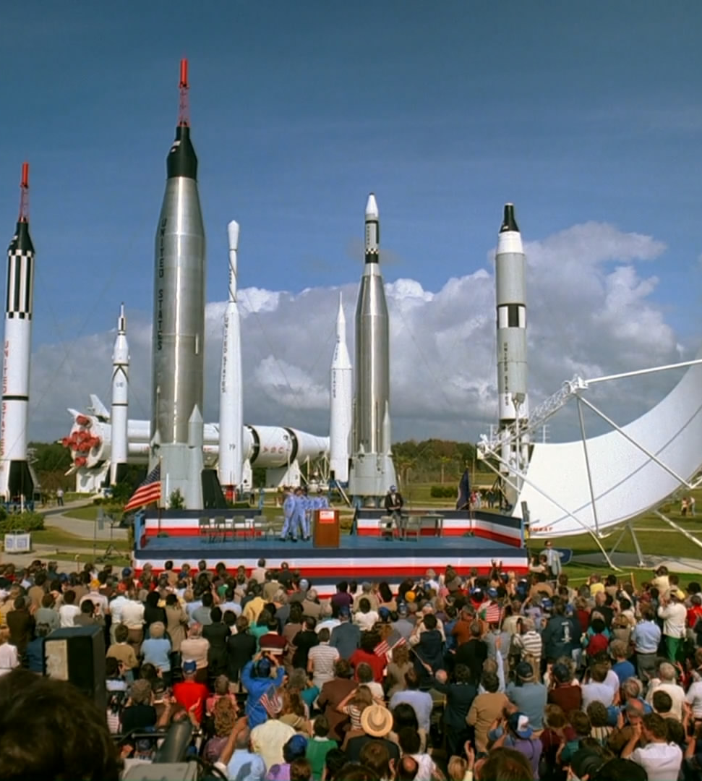
Cape Canaveral Activity Sample
Description: A closer look at launch records shows that Cape Canaveral is one of the most frequently used sites, especially for commercial and resupply missions.
Insight: Its operational frequency suggests this site plays a central role in mission scheduling and client service delivery. Enhancing logistics around this site may further improve efficiency.

Slide 22
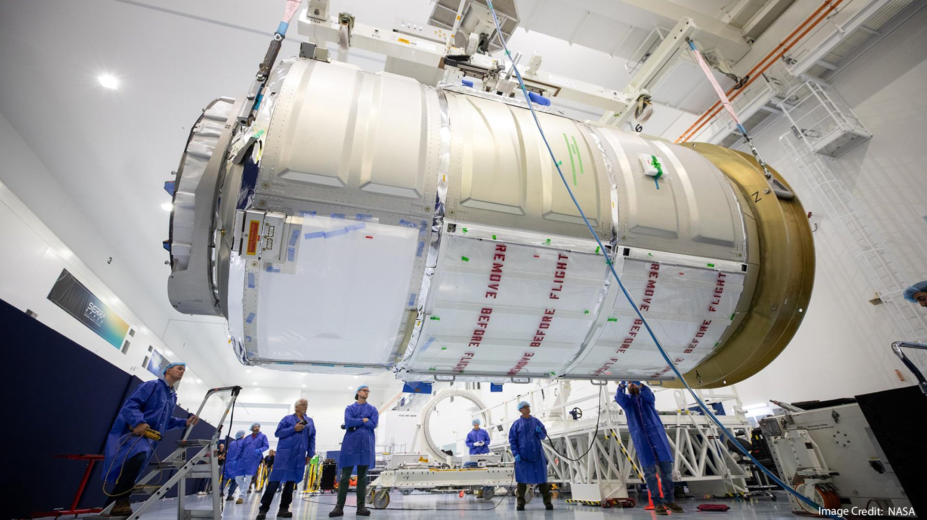
NASA Payload Contribution
Description: NASA has partnered with SpaceX through the Commercial Resupply Services (CRS) program. A cumulative analysis of payloads shows significant cargo mass handled for NASA missions.
Insight: This high volume reflects a strong and ongoing relationship with a key government client, reinforcing SpaceX’s role in public-private space collaboration.

Slide 23
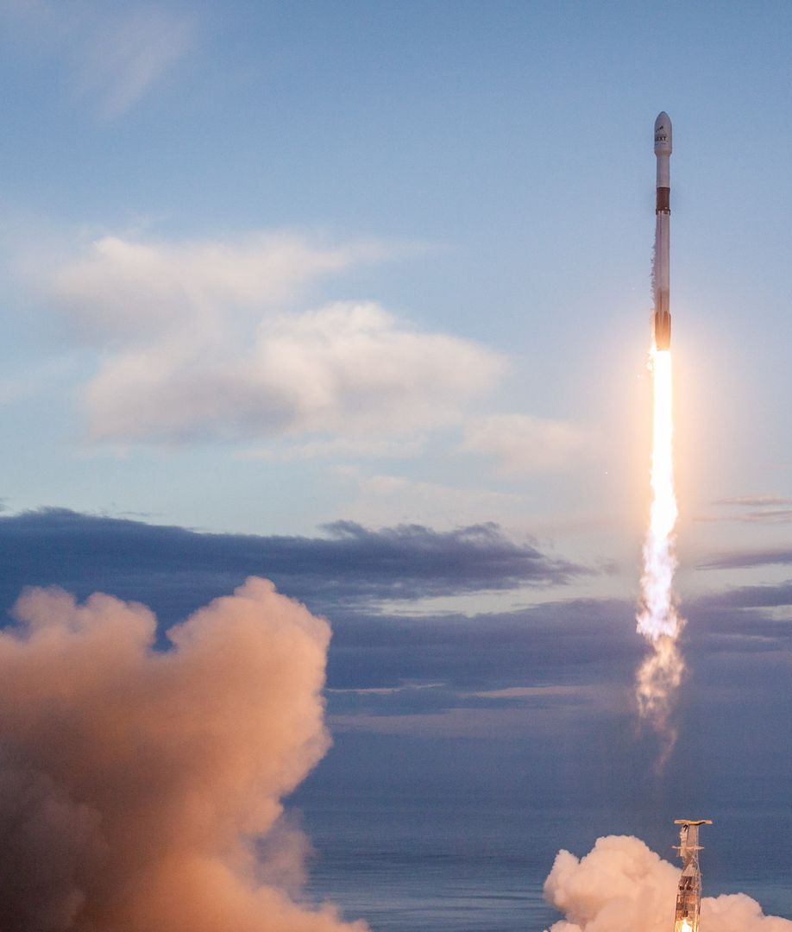
Average Payload Capacity by Booster
Description: The Falcon 9 v1.1 booster version has an average payload delivery of over X kg. This helps benchmark the booster’s performance in historical launches.
Insight: Monitoring average payload per booster supports performance evaluation and future design optimizations. Higher payload efficiency directly contributes to cost savings.

Slide 24
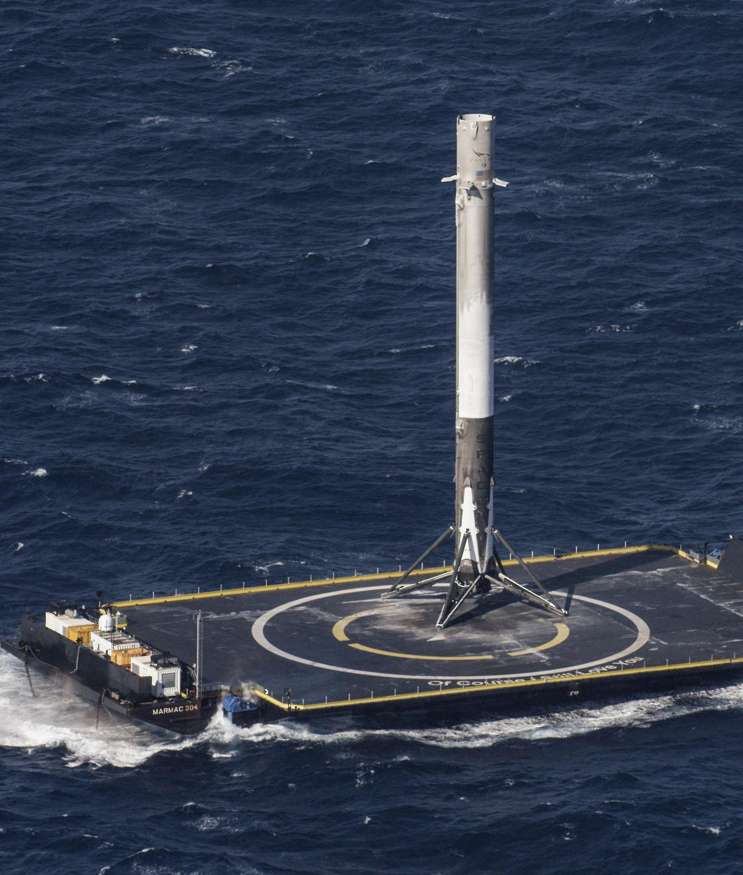
First Successful Ground Landing
Description: A major milestone was the first successful ground pad landing, recorded in [Month, Year], marking the beginning of a new phase in rocket reusability.
Insight: This event significantly reduced costs per launch and enabled quicker turnaround times. It's a foundational point for SpaceX's competitive pricing.

Slide 25
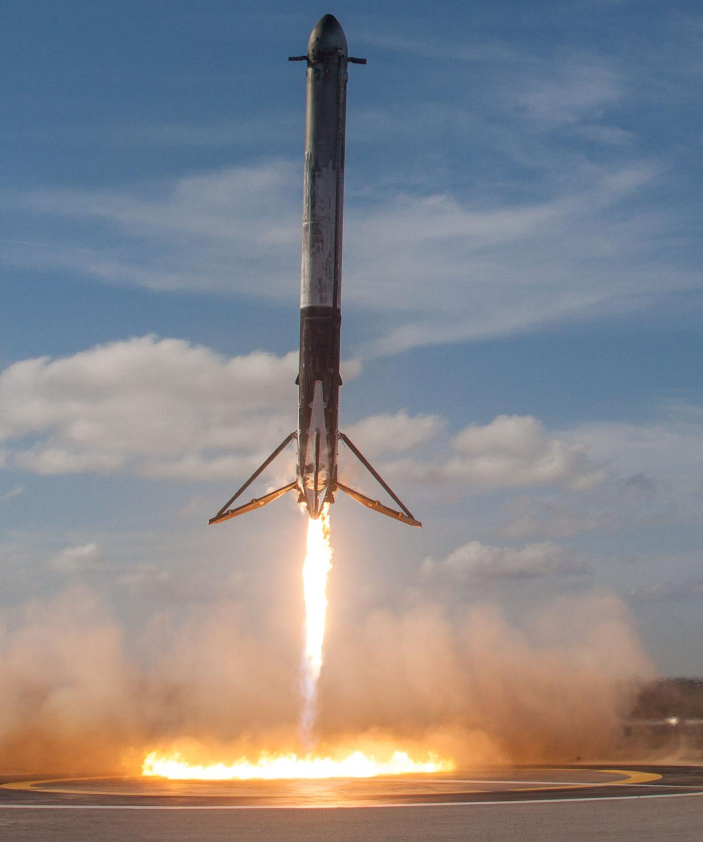
Top Performing Booster Versions
Description: By grouping and counting launches by booster version, we identified the most frequently used hardware configurations (e.g., Falcon 9 Block 5).
Insight: Usage trends can highlight reliable hardware, guiding maintenance, production prioritization, and mission planning with lower risk and higher confidence.

Slide 26

Key Takeaways from SQL Analysis
Summary:
Cape Canaveral dominates launch frequency.
NASA is a high-volume client.
Booster version matters for performance and cost.
Reusability is a core differentiator for SpaceX.

Slide 27

Folium Interactive Map Results

Slide 28
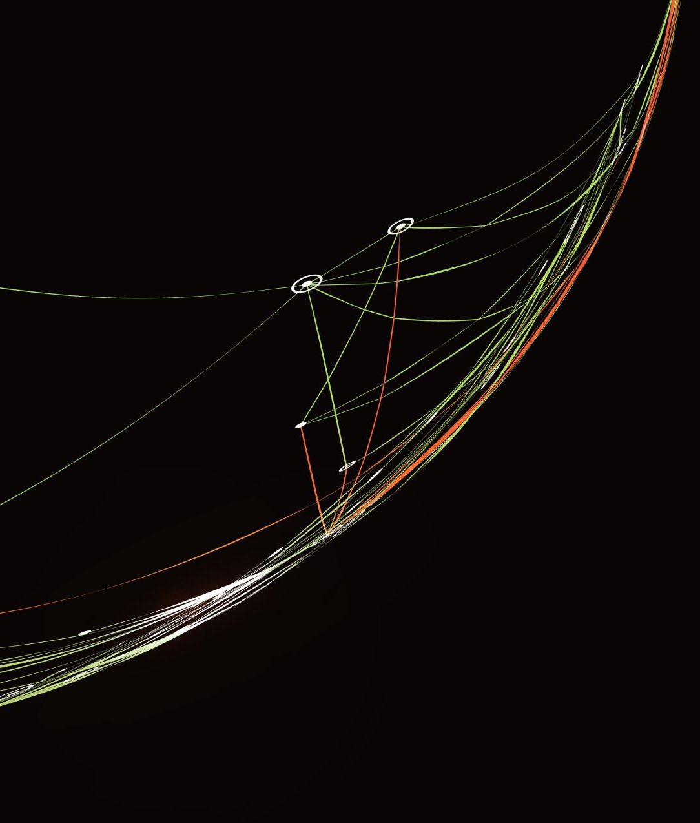
Launch Site Locations
Description: Using Folium, we mapped all SpaceX launch sites across the United States. Each site is marked with a clickable icon for interactivity.
Insight: The geographic distribution highlights a concentration of launch activities in Florida and California. This spatial visualization supports strategic decisions on future site expansion or logistics planning.

Slide 29

Launch Site Clustering by Success Rate
Description: We added visual indicators (circles or color-coded markers) around launch sites to reflect mission success or failure rates per location.
Insight: Some sites show higher historical success rates. This allows decision-makers to focus high-value or time-sensitive missions at proven sites, optimizing reliability.

Slide 30

Proximity Analysis with Nearby Infrastructure
Description: The Folium map also overlays the nearest cities and infrastructure around each site, helping evaluate the accessibility and support ecosystem of each location.
Insight: Sites near urban or industrial areas offer better access to support services, which can reduce cost and improve readiness for rapid launch cycles.

Slide 31

Plotly Dash Dashboard Results

Slide 32
Dashboard Overview SpaceX Launch Analytics
Description: This interactive dashboard provides a comprehensive view of SpaceX launch records, including success rates, payload trends, and booster performance across all sites.
Key Features:
Dynamic Filters: Compare data by launch site, payload range, and booster version.
Success Rate Visualization: Clear metrics on mission outcomes (e.g., 42% success at CCAFS SLC-40).
Payload Analysis: Trends between payload mass (kg) and launch success.
Insight: The dashboard enables real-time exploration of launch performance, helping identify patterns (e.g., higher success rates for mid-range payloads) and optimize future missions.

Slide 33

Launch Site Performance Comparison
Description: The dashboard highlights variations in success rates across launch sites (e.g., KSC LC-39A vs. CCAFS SLC-40).
Notable Observations:
KSC LC-39A: Higher success rates for payloads between 2,500–6,500 kg.
CCAFS SLC-40: Moderate success rates (37.1%–42%), with frequent launches in lower payload ranges.
Business Implication: Site selection can be tailored to payload requirements to maximize mission success.

Slide 34

Payload vs. Success Rate Trends
Description: Scatter plots and histograms reveal correlations between payload mass and launch outcomes.
Key Findings:
Optimal Payload Range: 3,000–5,000 kg shows higher success rates across sites.
Outliers: Extremely heavy payloads (>6,000 kg) have higher failure rates, suggesting technical or booster limitations.
Actionable Insight: Align payload design with optimal mass ranges to improve reliability.

Slide 35
Booster Version Analysis
Description: The dashboard categorizes launches by booster version (e.g., FT, B4, B5).
Trends:
FT Boosters: Most frequently used, with stable success rates.
B5 Boosters: Emerging as a reliable choice for heavier payloads.
Strategic Value: Tracking booster performance informs fleet upgrades and retirement decisions.

Slide 36

Filtering

Slide 37

Interactive Filters & Customization
Description: Users can filter data by:
Launch site
Payload range (0–9,000 kg)
Booster version
Why It Matters: Customizable views allow stakeholders to drill down into specific scenarios (e.g., “Show all B5 launches at KSC with 4,000–6,000 kg”).

Slide 38

Predictive Analysis

Slide 39

Methodology
Trained multiple classification models (Logistic Regression, SVM, Decision Tree) on historical SpaceX launch data.
Features: Payload mass, launch site, booster version, flight number, and orbital parameters.
Target: Binary classification (success = 1, failure = 0).
Key Results
Model Performance:
Decision Tree achieved the highest test accuracy: 94.4%.
Logistic Regression & SVM: ~83.3% accuracy.
Confusion matrices showed minimal false negatives for Decision Tree.

Slide 40

Critical Predictors:
Payload Mass: Strong correlation with success (optimal range: 3,000–5,000 kg).
Booster Reusability: Reused boosters had higher success rates.
Launch Site: KSC LC-39A showed better outcomes for heavy payloads.
Business Insight:
Prioritize mid-range payloads and reusable boosters to maximize mission success.
Use Decision Tree model for real-time success probability estimates.

Slide 41

Conclusion & Recommendations
Summary:
Exploratory Analysis: Identified payload and site-specific success patterns.
Predictive Modeling: Decision Tree reliably forecasts launch outcomes.
Next Steps:
Integrate predictive models into launch planning dashboards.
Investigate technical constraints for heavy payloads (>6,000 kg).

